Slide 1
[RFP] STM32 UART-to-USB HID Keyboard Bridge & PC Configurator
  Target Board: NUCLEO-C071RB Development Board (STM32C071RB MCU)
  Deliverables:
  STM32 Firmware (C/C++) + Windows PC Configurator Utility (.exe)
  Documentation & Debug Support:
    Clean, well-commented source code for both Firmware and PC Application.
    Setup & Build Guide (toolchain requirements, flash procedure, and debug tips).
    Communication protocol specification (packet format for settings read/write).

Slide 2
Background & Core Objective
Problem: 2D Barcode Scanners output raw UART ASCII streams (up to 1KB+ payloads) containing special non-printable control characters. Connecting these directly to Host PCs via raw UART can lead to missed characters or formatting errors in standard PC software (Notepad, Excel, etc.).
Solution: An STM32-based hardware bridge that receives raw UART ASCII characters and transparently converts them into standard US QWERTY USB HID keyboard strokes. (refer Appendix A.)
Key Requirements:
  Zero Data Loss: High-speed UART reception with sufficient buffer (1KB~2KB) to handle large barcode payloads (e.g. PDF417).?)
  In-System Configuration: Ability to update ASCII-to-HID lookup tables and UART settings over USB HID(?) without re-flashing firmware.
  Turnkey Delivery: Both firmware and a lightweight Windows GUI tool.

Slide 3
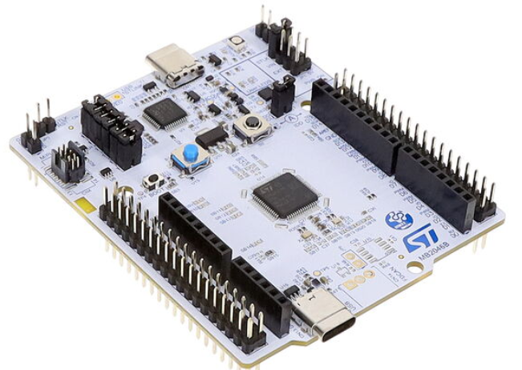
2: System Architecture & Data Flow
[Mode 1: Normal bridge Operation (Configurator Inactive)]
PDF417 scanner,
(Serial terminal program @Test PC )
UART Raw data
9600~115200 bps
STM32 HID Bridge
(ASCII → HID, by Lookup)
USB HID Keystrokes
(Standard US layout)
Host PC
(Notepad/ Excel)
UART
USB
USB-UART
(Virtual COM)
***Note, Single PC Setup for Testing: Test PC and Host PC can be the same physical PC running two applications simultaneously (a Serial Terminal and Notepad/Excel).
[Mode 2: Configuration Mode (PC Configurator Active)]
Windows PC App
(Configurator GUI)
USB HID Feature Report
(UART Baud Rate, Lookup Table R/W)
STM32 HID Bridge
(ASCII → HID Lookup) @ internal Flash
USB
***Note: Mode 1 and Mode 2 do not need to run simultaneously. Mode 2 is used only during (initial) configuration.

Slide 4
3: Key Requirements
STM32 Firmware Requirements
UART Data Reception: Cleanly handle fast burst data streams up to maximum PDF417 barcode payload sizes (~3KB max) without data loss or overrun.
ASCII to USB HID Translation: Translate incoming ASCII bytes into standard USB HID keycodes in real time using a special and control ASCII code Lookup Table (LUT). Refer to Appendix A for character mapping guidelines.
Configuration Interface: Support reading and writing configuration parameters (UART settings, inter-character delay, and Lookup Table) via USB HID interface or equivalent methods.
Non-volatile Storage: Retain user-configured parameters and Lookup Table in internal Flash memory across power cycles.
Keystroke Transmission Delay: Provide configurable inter-character delay (e.g., 0–20 ms) to ensure reliable keystroke delivery to slower host systems.
B. Windows PC Configurator App
Tech Stack: Open to suitable GUI frameworks (e.g., C#, etc.) delivered as a standalone Windows executable (.exe).
Primary Features:
  Device Connection: Auto-detect and connect to the target USB HID device.
  UART Settings Panel: Read, edit, and write Baud Rate (9600–115200 bps), Parity, Stop Bits, and Inter-character delays.
  Lookup Table Editor: Interactive table view to customize ASCII-to-HID key mappings, with support for importing mapping files (e.g., CSV).
  Control Actions: Support [Read Settings], [Restore Defaults], and [Save to Device] functions, etc.
  Firmware Upload: Interface to select and flash a new .bin firmware file.

Slide 5
4. Proposal Requirements (Call for Proposals)
We invite proposals that include the following details:
Technical Approach & Architecture Proposal:
  STM32 Firmware: Proposed architecture for STM32C071RB (DMA/Buffer ring design, internal Flash layout for saving settings and handling board resets/updates).
  PC-to-Board Communication Method: Recommended communication method between the PC App and STM32 board for reading/writing configuration data (e.g., USB HID Feature Reports, USB CDC, or Custom HID), including how the system seamlessly transitions between configuration mode and normal keyboard typing mode.
  PC App Design & User Experience (UX) Ideas: Proposed GUI concept and user flow. Instead of manually editing individual characters in the UI, and a file-based configuration workflow (e.g., Importing/Exporting settings via CSV or other) alongside preset options. Please suggest UI ideas for file management, preset selection, and quick flashing/writing to the device.
Timeline & Fixed-Price Quote: Estimated development timeline, proposed milestones, and total fixed-price quote.
Relevant Experience: Brief overview of past projects involving STM32 USB stack development, UART DMA handling, or PC-hardware configuration tools.
  * Warranty & Post-Handover Support:

Slide 6
Appendix A: Complete ANSI / AAMVA Control Delimiters & HID Mapping Reference
1. AAMVA Character Set Definitions (Standard Reference)
  3.1 alphabetic (A) – alpha characters/letters from A to Z and a to z
  3.22 numeric (N) – digits 0 to 9
  3.26 visual special characters (S) – ! " # % & ' ( ) * + , - . / : ; < = > ? [ \ ] ^ _ @ space
  3.2 ANS – any combination of A, N, or S characters
  Note: All printable ASCII bytes (0x20 to 0x7E) corresponding to A, N, and S (visual special characters) map 1:1 to standard US QWERTY USB HID keycodes (+Shift modifier where required) by default. Non-Printable Control Characters: Intercepted and translated according to the default lookup table or ignored.
2. Invisual / Non-Printable Control Characters (Default Action Mappings)
Non-printable ASCII control bytes in the raw stream must be intercepted and translated into action keys or ignored based on the user-configurable Lookup Table:
Hex Code | Control Code | Standard AAMVA Name | Default USB HID Target
0x0A | LF | Line Feed (Element Separator) | KEY_ENTER
0x0D | CR | Carriage Return (Header Terminator) | KEY_ENTER
0x1C | FS | Field Separator (Legacy Delimiter) | KEY_ENTER or KEY_TAB
0x1D | GS | Group Separator (Subfile Header Delimiter) | KEY_ENTER or KEY_TAB
0x1E | RS | Record Separator (Subfile/Record Delimiter) | KEY_ENTER or KEY_TAB
0x1F | US | Unit Separator (Segment Unit Delimiter) | KEY_ENTER or KEY_TAB

Slide 7
Appendix A: Complete ANSI / AAMVA Control Delimiters & HID Mapping Reference
3. Firmware Lookup Table Initialization Rules (256-Byte Array)
To ensure robust handling of the full 0x00–0xFF ASCII range, the 256-byte firmware lookup table must be initialized using the following default fallback rules:
1. **AAMVA Control Delimiters (`0x0A`, `0x0D`, `0x1C`, `0x1D`, `0x1E`, `0x1F`)**:
- Map to action keys (`KEY_ENTER` or `KEY_TAB`) as defined in the table above.
2. **Printable ASCII (`0x20` to `0x7E`)**:
- Map 1:1 to standard US QWERTY USB HID keycodes (+Shift modifiers where required).
3. **All Other Non-Printable Control Characters (`0x00`–`0x09`, `0x0B`, `0x0C`, `0x0E`–`0x1B`, `0x7F`)**:
- Map to **`0x00` (Ignore / Skip)** so they are filtered out and not transmitted to the host PC.

